Slide 1

Task Description
Given
A sampled POI dataset in Shanghai
Bing Map SDK which can
obtain the location of a point (e.g. the red star shown in the example)
overlap information (including push-pins and lines) on a map
Build a query-answer engine
Two types of queries: KNN and spatial range query
Using any indexing and retrieval algorithms taught in the course
Concerned with efficiency
The query location, spatial range and category of POIs are variables
Build a simple interface that can
Accept user-specified queries
Visualize the results (a map-based view is preferred)
Yu Zheng
yuzheng@microsoft.com

Slide 2
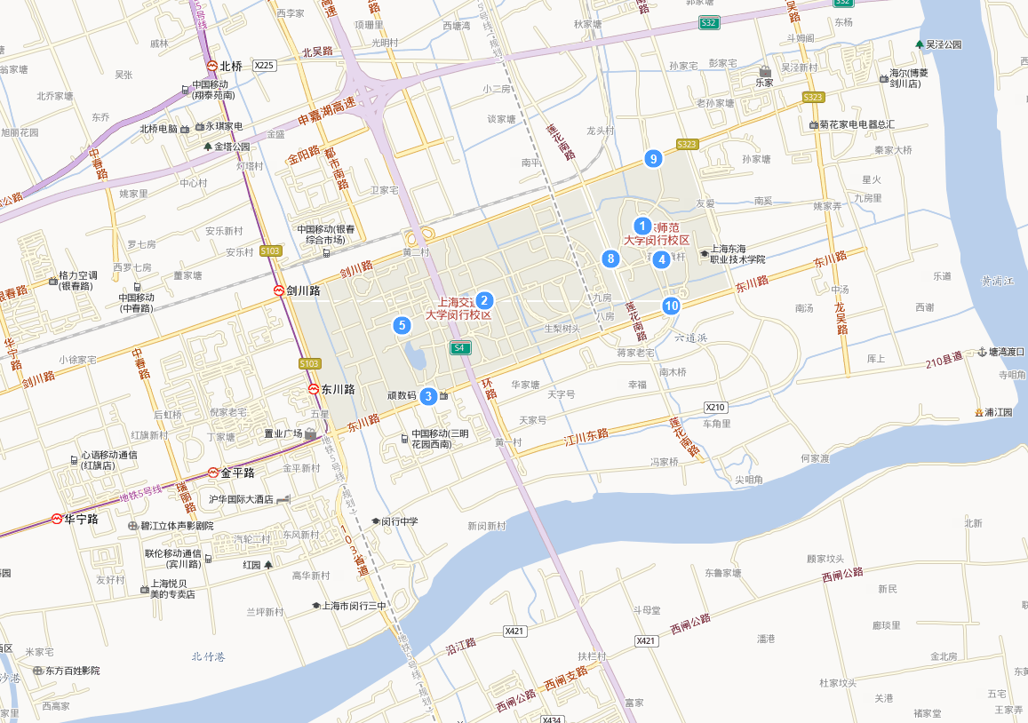
Task Example – Urban Computing
Find the nearest ATM round the red-star marker?
How many Chinese restaurants within 500 meters of the red-star marker?
Blue labels are variables specified by users through an interface

